Slide 1
Parent/Carer Questionnaire
Athersley South Primary School
March 2022

Slide 2
A questionnaire was sent out to all parents and carers of children who have children on roll at our school.
At the time of this evaluation we had received 72 responses. The number of children represented is much higher as we have had a number of replies from families with more than one child. According to the final question, 91 children are represented but a definitive figure is not available as we cannot be certain that all Parents and Carers indicated all the year groups in which their children attend.
The information on the following slides shows the analysis of the information that we received, a celebration of the strengths Parents and Carers identified and areas that they felt could be improved further within school.

Slide 3
Question 1 : My child is happy at this school

Slide 4
Question 2 : My child feels safe at this school

Slide 5
Question 3: Staff encourage children to behave well by having good relationships and high expectations

Slide 6
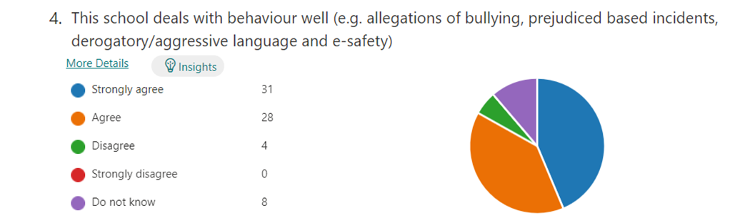
Question 4: This school deals with behaviour well (e.g. allegations of bullying, prejudiced based incidents, derogatory/aggressive language and e-safety)

Slide 7
Question 5: This school makes me aware of what my child will learn during the year

Slide 8
Question 6: There is a good range of subjects available to my child at this school (broad and balanced curriculum)

Slide 9
Question 7 : This school has high expectations for my child

Slide 10
Question 8 :This school lets me know how my child is doing

Slide 11
Question 9 : Does your child have Special Education Needs and/or disabilities (SEND)

Slide 12
Question 10 : My child has SEND and this school gives them the support that they need to succeed

Slide 13
Question 11: This school provides my child with good opportunities to learn from visitors and by going on trips *NB please take into account pre-Covid when responding to this question

Slide 14
Question 12: My child’s needs are met and supported well at this school (broad and balanced curriculum, learning needs met)

Slide 15
Question 13: Staff deal with issues concerning my child quickly and effectively

Slide 16
Question 14 : This school places a high emphasis on attendance and punctuality

Slide 17
Question 15 : This school provides regular feedback on how my child is doing

Slide 18
Question 16 : I would recommend this school to other parents

Slide 19
Question 17 : What does this school do well?
Fantastic school.
Ensuring my child is happy and learning I couldn't ask for anything more.
Everything.
My children’s teachers this year have gone above and beyond to support my children. This I’m grateful for.
If you have any problems they sort it as best and fast as possible.
This school has helped me get referrals to specialist when needed. They have help so much with my child's learning.
Safe Environment and quick response to any queries I may have.
Brilliant staff.
Communication through email i.e. newsletters, school information.
Positive praise.
Look out for pupils’ safety.
Supporting children with their learning and progress is second to none. The teachers and staff are approachable and act upon concerns in a timely and professional manner. Very friendly school. Like being part of a big family.
Be informative.
The school comes across as being 'together' like one big family.
Encourage children.

Slide 20
Question 17 : What does this school do well?
Help my child when it is needed.
It’s a very open community and I love how when it’s parents evening or any other events in school it’s very relaxed and just normal.
Great teachers, always so helpful and are always giving praise where due.
Teaching manners to children.
They let me know if my child has had an accident.
I think it offers a wide range of opportunities.
The EYFS are fantastic and incredibly caring.
Strong communication.
The school is good at communicating with parents in any situation.
Nearly everything.
Communication, staff always friendly and approachable.
Very safe place for my children to attend, my children are very happy at school.
Give regular feedback about my child’s learning and progress through parents’ evenings
Listens to us parents and the children.
Engaging children with learning and behaviour.

Slide 21
Question 18 : What else could this school do to improve further?
Regular updates on learning
A class newsletter perhaps once a term saying what my child will learn in the coming term.
There needs to be more opportunities for trips and visitors.
More communication on new teachers/teaching assistants.
More school trips and themed school days.
I would like to know what my child has had for dinner.
Communication
Set up a safe space where children can go at anytime and freely discuss any issues/problems they may be having in school or out of school
More after school clubs and improve the number of spaces.
Extending breakfast club from 8am to 7am which will really help parents.
Better school dinner that children actually eat.

Slide 22
Question 18 : What else could this school do to improve further?
Send out updates for classes on what the children have been or are going to be learning about as this is unclear. My child doesn't like to talk about school when he gets home so I do not know what topics they are studying.
When dropping kids off and picking kids up it all seems rushed!
Updates via text on subjects for example learner for the week or maybe involving parents email/text on how our children are doing.
Provide parents with a timetable so we know what subjects are taking place each day.
Class sizes are too big, children who need extra support are unable to get it due to staffing issues however I appreciate this is out of the school’s control.
Provide extra support / one to one for children struggling.
Understanding families within the school.
More communication from teachers, more fun activities for younger years as they still learn through play.
Give the children who are good all of the time a treat.

Slide 23
Question 18 : What else could this school do to improve further? Our Response…1/2
Parents/Carers Said They Would Like… | ASPS Response
Regular updates on learning/A class newsletter saying what my child will learn in the coming term | We are currently exploring different formats and will look to introduce something for all year groups from September. In the meantime, we may consult with some parents as we review and evaluate different options so we can best understand how you prefer the information to be presented.
More school trips, visitors and themed school days | We appreciate that covid has restricted these opportunities but plans are now underway for children to participate in educational visits again. We aim for all children to participate in at least one visit off site a year. We have some visitors planned for Term 3 to support the children’s learning including the Fire Service. A Jubilee themed day is planned for May and a Spanish themed day for July to support our curriculum offer. We also regularly participate in fundraising days and anti-bullying initiatives.
Better communication, including new staff | Our First Friday Newsletter is a key tool in our communication with you and allows us to provide general updates and information. Further letters are sent out about class specific or other matters e.g. clubs. Ordinarily we do not have many staff changes within the school year, but we do appreciate that this year has been more difficult due to staff absence.
More after school clubs and increased capacity | We do currently offer a range of clubs, but will look to offer more if/when we have the staffing capacity. Sometimes numbers have to be limited for safety reasons.
Improved school dinners | Our school meals are provided by Barnsley Schools Catering Service. They have recently launched a new menu, with additional options that have so far been well received by the children. The meals are nutritious and there are a range of options each day.
To allow Parents to know what their child has had for dinner | This option is already available via the ParentPay App and you can view your child’s school meals history. If you are unsure how, please contact school.
Extending Breakfast Club hours | Unfortunately, at the moment we are unable to extend the hours as our Breakfast Club staff also work in school during the day. A consultation did go out previously with a private provider, but at that time there was insufficient interest in an earlier start time to make it a viable option.

Slide 24
Question 18 : What else could this school do to improve further? Our Response…2/2
Parents/Carers Said They Would Like… | ASPS Response
Provide daily timetables | This is something we will look to include within a termly newsletter/curriculum update. However, our timetables can be quite fluid so may not always reflect exactly what your child does each day.
Updates via text | We do endeavour to send out texts where appropriate. You suggested a text when a child receives a Learner of the Week award. Pre-covid, Parents/Carers were invited into assembly to watch their child receive their certificate so knew about it and could be there too. With the return of whole school assemblies we also hope to resume the practice of inviting Parents/Carers in too 😊.
Reward children who behave well | Our behaviour reward system does seek to reward good behaviour through our ‘success stones’, team trips and certificates. We always welcome other ideas too.
Understand families within the school | We strive hard to know all our families in school well and to support you as well as your children. If you feel there are gaps in our understanding, please do contact school.
Have more time for Parents at drop off/pick up time | The environment at entry and exit times is busy and staff need to monitor all children for safeguarding reasons, so cannot always engage in conversations with Parents/Carers. That said, if you need to speak with your child’s teacher, please call school before/after the school day to speak with them where the matter is urgent, or request a call back/make an appointment to see them. We want to give you our full attention when speaking with you and entry/exit times are often not appropriate. Mrs Smart our Parent Support Advisor and Mrs Walch, Learning Mentor, are also usually available at the beginning/end of the day and they can be contacted via main school reception. They can often provide advice/support or pass messages on to class teachers.
Provide extra support/1:1 For children struggling | Please be assured that we are constantly monitoring the progress of every child within school and if we identify there is a need for additional support we will plan for this to happen. We will then monitor and evaluate the impact of this support. If you have any concerns about your own child’s progress or the support they receive, please do contact school.

Slide 25
Question 19 : Please indicate what year group your child is in. If you have more than one child, please tick all boxes that apply.

